Slide 1


Patient Data Analytic Tool For Emergency Rooms
Department of Computer Science and Engineering
GE19612
Naveen Kumar K (210701174)
Navya Balasundaram (210701177)
Oviya K (210701186)
Dr . K.Ananthajothi M.E.,Ph.D.,
PROJECT COORDINATOR

Slide 2
ABSTRACT
With growing population, hospitals find it difficult to operate seamlessly, especially in emergency rooms due to proportional growing data. The number of patients as well as the need for resources, medicines and clinical supplies has increased greatly. Furthermore, with greater increase in data, arises a need for better analysis and visualization of such data. Our goal is to give hospitals the tools they need to effectively analyze this data as statistics, enabling them to decide how best to allocate their resources and improve overall operational effectiveness. Our tool helps with analyzing and visualizing these on various scales and criteria against one another. It will give numerous key take-aways to the hospital on what to expect from any new incoming patient and how to care for them more effectively.

Slide 3
EXISTING SYSTEM
Hospitals struggle to run efficiently as the population grows, particularly in emergency departments where data is expanding proportionately. Both the quantity of patients and the need for supplies, medications, etc., have skyrocketed. An increased volume of data necessitates improved data analysis and visualization. Hospitals are only able to make better decisions for a more effective operation of the facility when the data is analyzed as statistics.
Not only this, but having a rough estimate of any resource and their availability is what is being done in many small hospitals, the exact real time count is not tracked. The staff do not look at real time data of the patients or the resources at all. But this real time data can be immensely helpful for the functioning of a hospital.

Slide 4
PROPOSED SYSTEM
The aim of this project is to create and execute a system enabling hospitals to analyze and visualize data, tackling the difficulties brought about by an expanding population and a corresponding rise in the quantity of patients. The intention is to give hospitals the tools they need to analyze this data as statistics, enabling them to decide how best to allocate their resources and improve overall operational effectiveness. With Dash for visualization and for data administration, the system will give users immediate insights into important KPIs. It also provides a 24/7 real-time resource count for emergency rooms.
The utility of Dash lies in its ability to democratize data analysis by providing a platform where stakeholders can interactively explore data insights. Through the web application, users can filter and drill down into specific datasets, toggle between different visualizations, and gain deeper insights into trends and patterns. This interactivity enhances decision-making processes by enabling real-time exploration of data, which is particularly useful for projects requiring rapid analysis and informed decision-making.

Slide 5
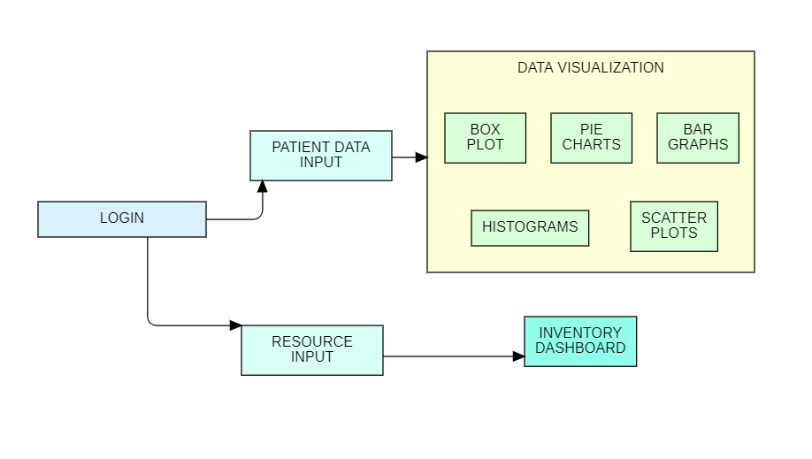
SYSTEM ARCHITECTURE

Slide 6
LIST OF MODULES
LOGIN PAGE
PATIENT DATA INPUT PAGE
DATA ANALYSIS PAGE
RESOURCE INPUT PAGE
INVENTORY DASHBOARD PAGE

Slide 7
FUNCTIONAL DESCRIPTION OF EACH MODULE
LOGIN PAGE
This page contains the form to fill the login credentials by the hospital authorities, since only that particular hospital will use it, there are no multiple users. An option to change the password is also provided to enhance security.
PATIENT DATA INPUT FORM
This page contains the form where the patient data is collected, it contains appropriate text fields as well as dropdown fields for easy filling. It collects important information such as age, presence of comorbidities, cause of accident if so, department they were referred to etc. This is the crucial data on which analysis will be done. All the fields are required to be filled without fail before submitting as everything is a crucial information.

Slide 8
DATA ANALYSIS PAGE
This is the main page where multiple graphs will be visible showing the analysis real time. It will be based on the patient data collected currently along with everything collected till date. It will show various graphs such as bar graphs, pie charts, scatter plots, histograms, stacked bar charts, and many other bivariate and multivariate graphs. These will be plotted on various different combinations of fields on all the axes. This will help the facility understand the current trend and make better decisions for the patients as well as the organization.
RESOURCES INPUT FORM
This page will collect input of the resources in the form of checkboxes, showing all resources. When the checkbox is ticked, the resources in use will in incremented in the database. This count will automatically be reset to initial total count at the end of 24 hours, since a specific patient cannot be kept in the emergency room for more than a day. They will be sent to other speciality care departments or for monitoring.
INVENTORY DASHBOARD PAGE
This page will show the dashboard of real time count of resources. It will show their total count and the count in use.

Slide 9
CONCLUSION
In conclusion, this data analysis project has successfully demonstrated the power and versatility of using Python-based technologies like Plotly and Dash to create effective data visualization tools and resource management dashboards. By developing a web-based visualization page with a rich assortment of charts including bar graphs, pie charts, histograms, scatter plots, and more, we have provided users with intuitive means to explore and understand complex datasets. These interactive visualizations enable stakeholders to uncover insights, identify trends, and make data-driven decisions.
Moreover, the implementation of a dashboard showcasing total resources and their utilization status adds a practical dimension to the project, offering a real-time snapshot of resource allocation and usage. This dashboard serves as a valuable tool for monitoring resource availability, optimizing utilization rates, and ensuring efficient resource management practices

Slide 10
REFERENCES
[1] T. Anderson and S. Dragićević, "Complex spatial networks: Theory and geospatial applications", Geography Compass, vol. 14, no. 9, Sep. 2020
[2] M. Bastian, S. Heymann and M. Jacomy, "Gephi: An open source software for exploring and manipulating networks", Proc. Int. AAAI Conf. Web Social Media, vol. 3, no. 1, pp. 361-362, Mar. 2009.
[3] S. Batt, O. R. Harmon and P. Tomolonis, "Learning tableau: A data visualization tool", J. Econ. Educ., vol. 51, no. 3, pp. 317-328, 2020
[4] M. Behrisch, L. Bieker, J. Erdmann and D. Krajzewicz, "SUMO—Simulation of urban mobility—An overview", Proc. 3rd Int. Conf. Adv. Syst. Simulation, pp. 55-60, 2011.
[5] G. Boeing, "OSMnx: A Python package to work with graphtheoretic OpenStreetMap street networks", J. Open Source Softw., vol. 2, no. 12, pp. 215, Apr. 2017..

